Slide 1
Chapter 3-1 Transistors & Logic Gates
计算机系统概论
Introduction to Computing Systems
（CS1002A.01）
苗付友
mfy@ustc.edu.cn 2022 Fall
计算机科学与技术学院
School of Computer Science and Technology

Slide 2
Outline
1
Review
2
The Transistor
3
Logic Gates
4
Summary

Slide 3
Outline
1
Review
2
The Transistor
3
Logic Gates
4
Summary

Slide 4
Review
Great Idea #0: Great Idea from Ancient Chinese Philosophy(Bits and Bytes)
How do we represent data in a computer?
Bits: 0/1
Data type: representation and operations within the computer
Integer Data Types
Unsigned Integers
2’Complement Integers
Fixed-Point Data Types
Floating-Point Data Types
Text – characters, strings, …
Images – pixels, colors, shapes, …
Sound
Instructions
……
Arithmetic and Logical Operations
Binary-Decimal Conversion

Slide 5
Today
Microprocessors contain millions of transistors
Intel Core 2 Duo: 291 million
AMD Barcelona: 463 million
IBM Power6: 790 million
Transistor: Building Block of Computers
Logically, each transistor acts as a switch
Combined to implement logic functions
AND, OR, NOT

Slide 6
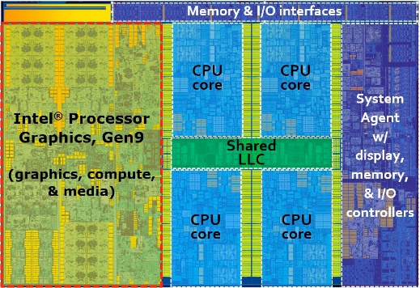

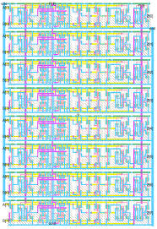
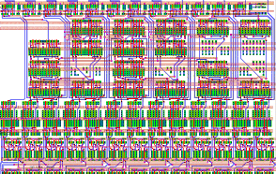
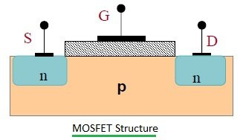
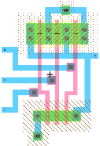
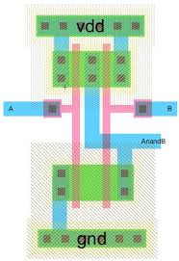
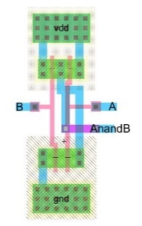
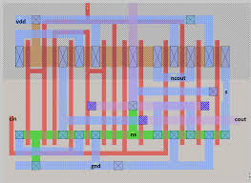
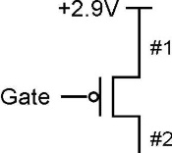
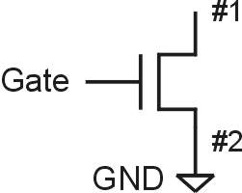
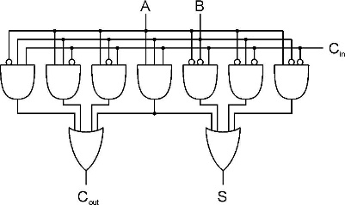
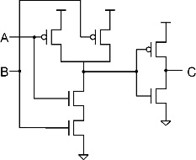
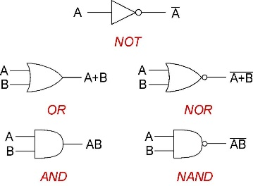

Approach: Bottom Up
ALU
Full Adder
_{Integrated Circuit Design}
_{100 Modules/ IC}
_{0.25M~20G Devices}
Register Transfer Level (RTL) Design
_{1K~10K Cells/Module}
_{(100K Devices)}
Now, You are Here.
A
B
C_{in}
_{Gete Level Design}
_{Transistor Physical Layout}
+
Clk
Register
C_{out}
S
_{Scheme for}
_{Representing Information}
_{Circuit Level Design}
_{（Transistor Level Design）}
_{(2~8 Devices/Gate)}
Register Transfer Level (RTL) Design
_{2~16 Gates/Cell}
_{(16~64 Devices)}

Slide 7
Great Idea #3: Abstraction Helps Us Manage Complexity
Application
Solve a system of equations
Algorithm and Data Structure
Gaussian
elimination
Jacobi
iteration
Programming Language/Compiler
Red-black SOR
Multigrid
Operating System/Virtual Machines
Instruction Set Architecture (ISA)
FORTRAN
C
C++
Java
Microarchitecture
Sun SPARC
Intel x86
IBM PowerPC
Gates/Register-Transfer Level (RTL)
Pentium 4
Core 2 Duo
AMD Athlon X2
Analog/Digital Circuits
Electronic Devices
Ripple-carry adder
Carry-lookahead adder
Physics
Static CMOS
Dynamic CMOS
Nanomechanical

Slide 8
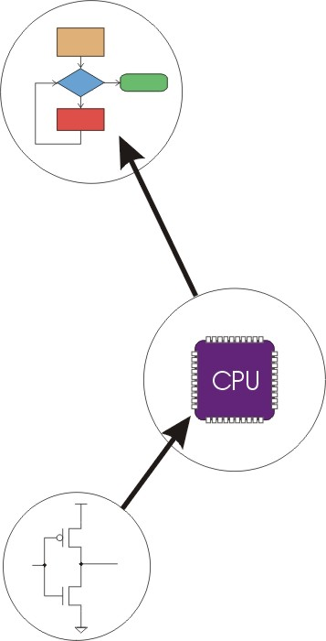
Great Idea #4: Software and Hardware Co-design
Application
Algorithm & Data Structure
Language
Software
Machine Architecture, ISA
Hardware
Microarchiture
Logic and IC
Now, You are Here.
Device
Computer System: Layers of Abstraction
Notes:
8

Slide 9
Outline
1
Review
2
The Transistor
3
Logic Gates
4
Summary

Slide 10
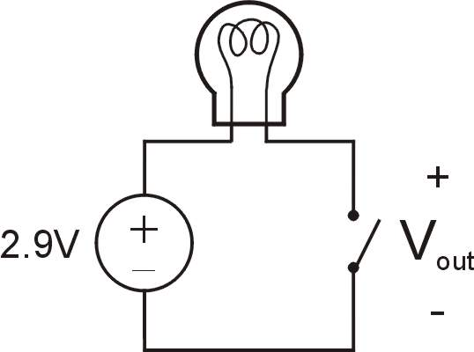
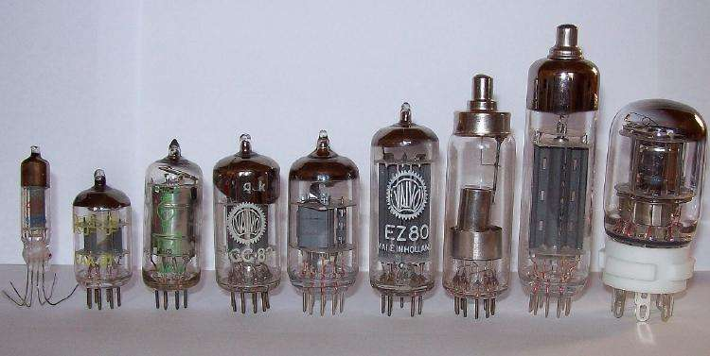
Vacuum tubes used as switches
Switch open:
No current through circuit
Light is off
V_{out} is +2.9V
Switch closed:
Short circuit across switch
Current flows
Light is on
V_{out} is 0V
Switch-based circuits can easily represent two states:
on/off, open/closed, voltage/no voltage.
Notes:
10

Slide 11
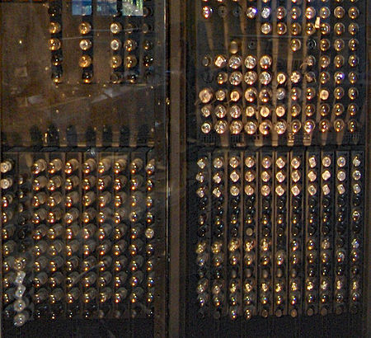
Vacuum tubes used as switches made electronic computing
1946，the ENIAC computer used 17,468 vacuum tubes and consumed 150 kW of power
Vacuum tubes used as switches made electronic computing possible for the first time, but the cost and relatively short mean time to failure of tubes were limiting factors."The common wisdom was that valves—which, like light bulbs, contained a hot glowing filament—could never be used satisfactorily in large numbers, for they were unreliable, and in a large installation too many would fail in too short a time".Tommy Flowers, who later designed Colossus, "discovered that, so long as valves were switched on and left on, they could operate reliably for very long periods, especially if their 'heaters' were run on a reduced current". In 1934 Flowers built a successful experimental installation using over 3,000 tubes in small independent modules; when a tube failed, it was possible to switch off one module and keep the others going, thereby reducing the risk of another tube failure being caused; this installation was accepted by the Post Office (who operated telephone exchanges). Flowers was also a pioneer of using tubes as very fast (compared to electromechanical devices) electronic switches. Later work confirmed that tube unreliability was not as serious an issue as generally believed; the 1946 ENIAC, with over 17,000 tubes, had a tube failure (which took 15 minutes to locate) on average every two days. The quality of the tubes was a factor, and the diversion of skilled people during the Second World War lowered the general quality of tubes. During the war Colossus was instrumental in breaking German codes. After the war, development continued with tube-based computers including, military computers ENIAC and Whirlwind, the Ferranti Mark 1 (one of the first commercially available electronic computers), and UNIVAC I, also available commercially.
Advances using subminiature tubes included the Jaincomp series of machines produced by the Jacobs Instrument Company of Bethesda, Maryland. Models such as its Jaincomp-B employed just 300 such tubes in a desktop-sized unit that offered performance to rival many of the then room-sized machines.

Slide 12
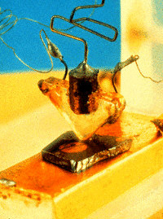
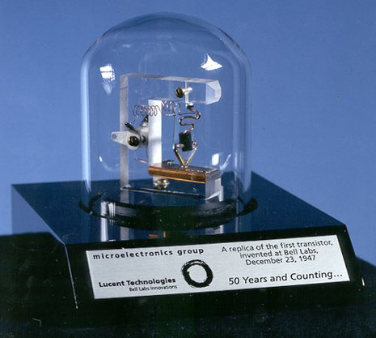
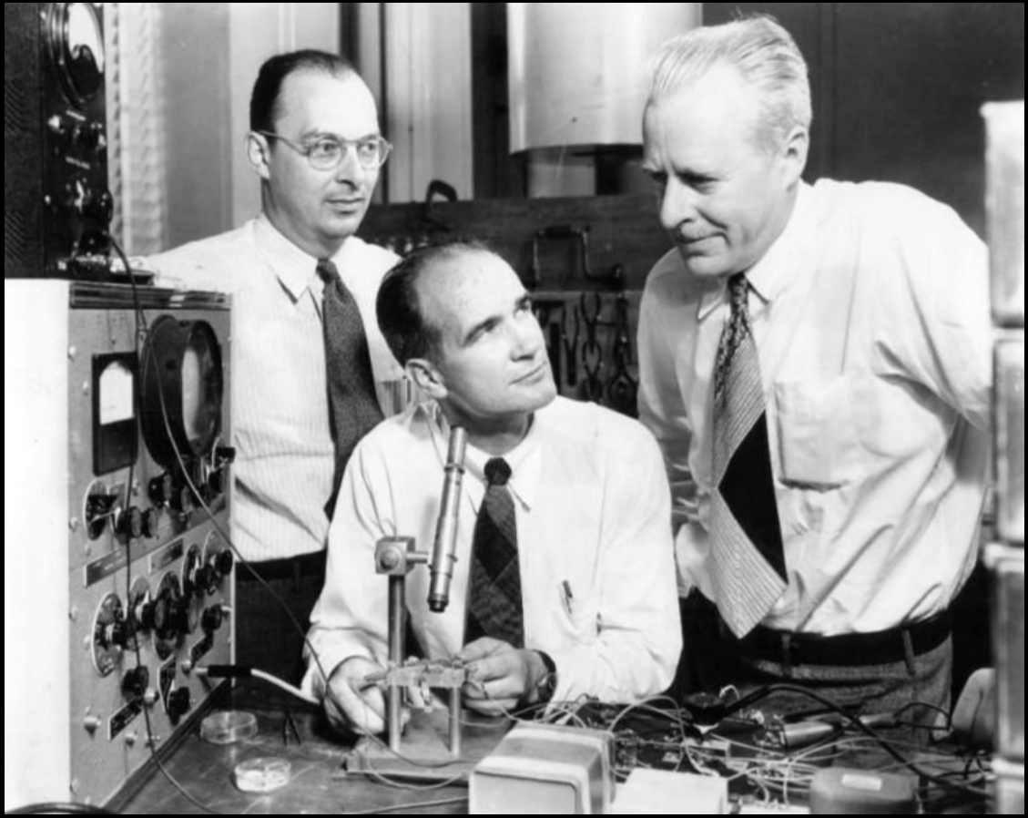
The invention of the transistor
Bell Labs lays the groundwork
1945: Bell sets up lab in the hopes of developing “solid state” components to replace existing electromechanical systems. William Schockley, John Bardeen, Walter Brattain: all solid-state physicists. Focus on Si and Ge.
1947：The Invention of the First Transistor- the point-contact transistor
1951: Shockley develops junction transistor which can be manufactured in quantity.
1954: The first transistor radio! Also, TI makes first silicon transistor (price $2.50)
1956: Bardeen, Shockley, Brattain receive Nobel Prize.

Slide 13
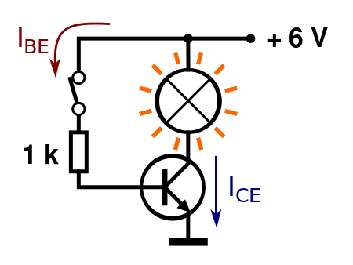
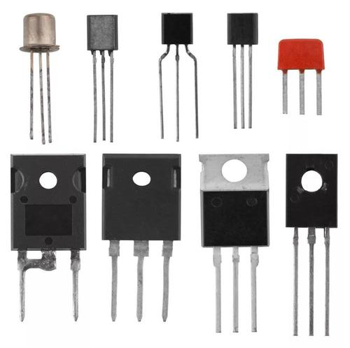
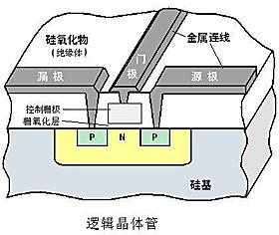
Transistor as a switch
Switch open:
No current through circuit
Light is off
V_{out} is +2.9V
Switch closed:
Short circuit across switch
Current flows
Light is on
V_{out} is 0V
Switch-based circuits can easily represent two states:
on/off, open/closed, voltage/no voltage.
Notes:
13

Slide 14
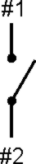
N-type MOS Transistor
Gate = 1
Gate = 0
Terminal #2 must be
connected to GND (0V).
MOS = Metal Oxide Semiconductor
two types: N-type and P-type
N-type metal–oxide–semiconductor (NMOS)
N-type
when Gate has positive voltage, short circuit between #1 and #2 (switch closed)
when Gate has zero voltage, open circuit between #1 and #2 (switch open)
Notes:
14

Slide 15
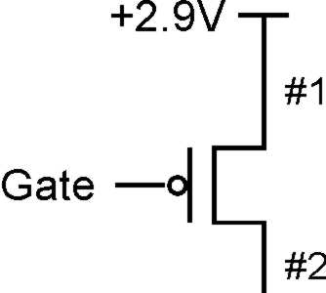
P-type MOS Transistor
Gate = 1
Gate = 0
Terminal #1 must be
connected to +2.9V.
P-type metal–oxide–semiconductor (PMOS)
P-type is complementary to N-type
when Gate has positive voltage, open circuit between #1 and #2 (switch open)
when Gate has zero voltage, short circuit between #1 and #2 (switch closed)
Notes:
15

Slide 16
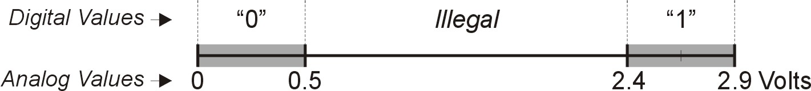
Logic Gates
Use switch behavior of MOS transistors to implement logical functions: AND, OR, NOT.
Digital symbols:
recall that we assign a range of analog voltages to each digital (logic) symbol
assignment of voltage ranges depends on electrical properties of transistors being used
typical values for "1": +5V, +3.3V, +2.9V, +1.1V
for purposes of illustration, we'll use +2.9V

Slide 17
CMOS Circuit
CMOS: Complementary MOS
Uses both N-type and P-type MOS transistors
P-type
Attached to + voltage
Pulls output voltage UP when input is zero
N-type
Attached to GND
Pulls output voltage DOWN when input is one
For all inputs, make sure that output is either connected to GND or to +,but not both!

Slide 18
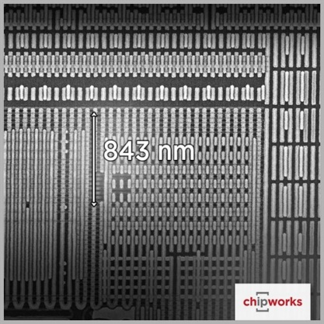
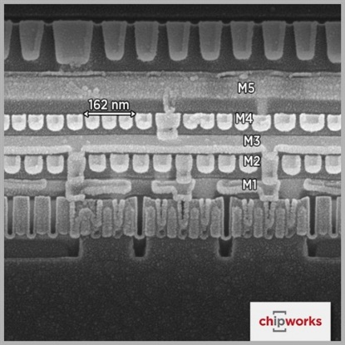
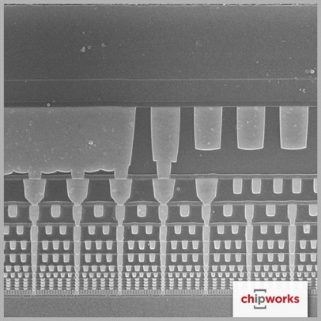
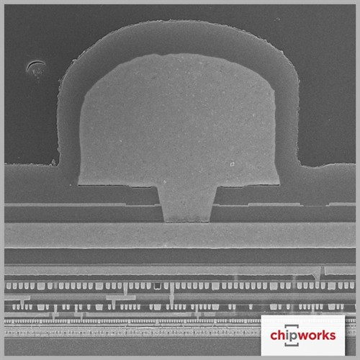
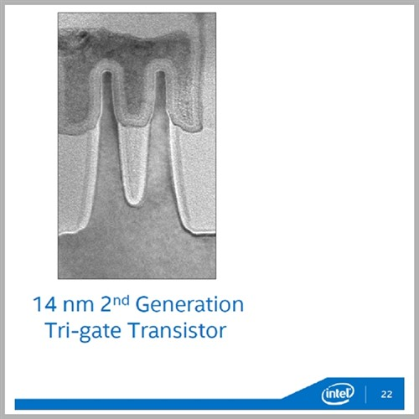
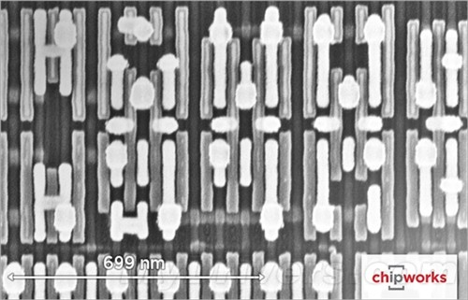
A transistor under a microscope
http://www.zhihu.com/question/26998618
How is it possible to have tens of millions of transistors in a chip?
显微镜下的intel 14纳米晶体管

Slide 19

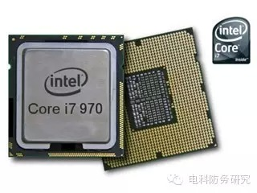
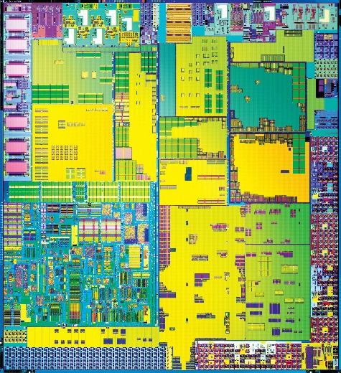
Microprocessors contain millions of transistors

Slide 20
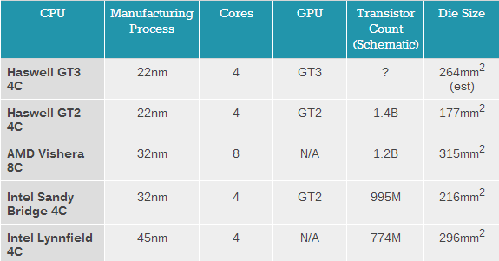
Microprocessors contain millions of transistors

Slide 21
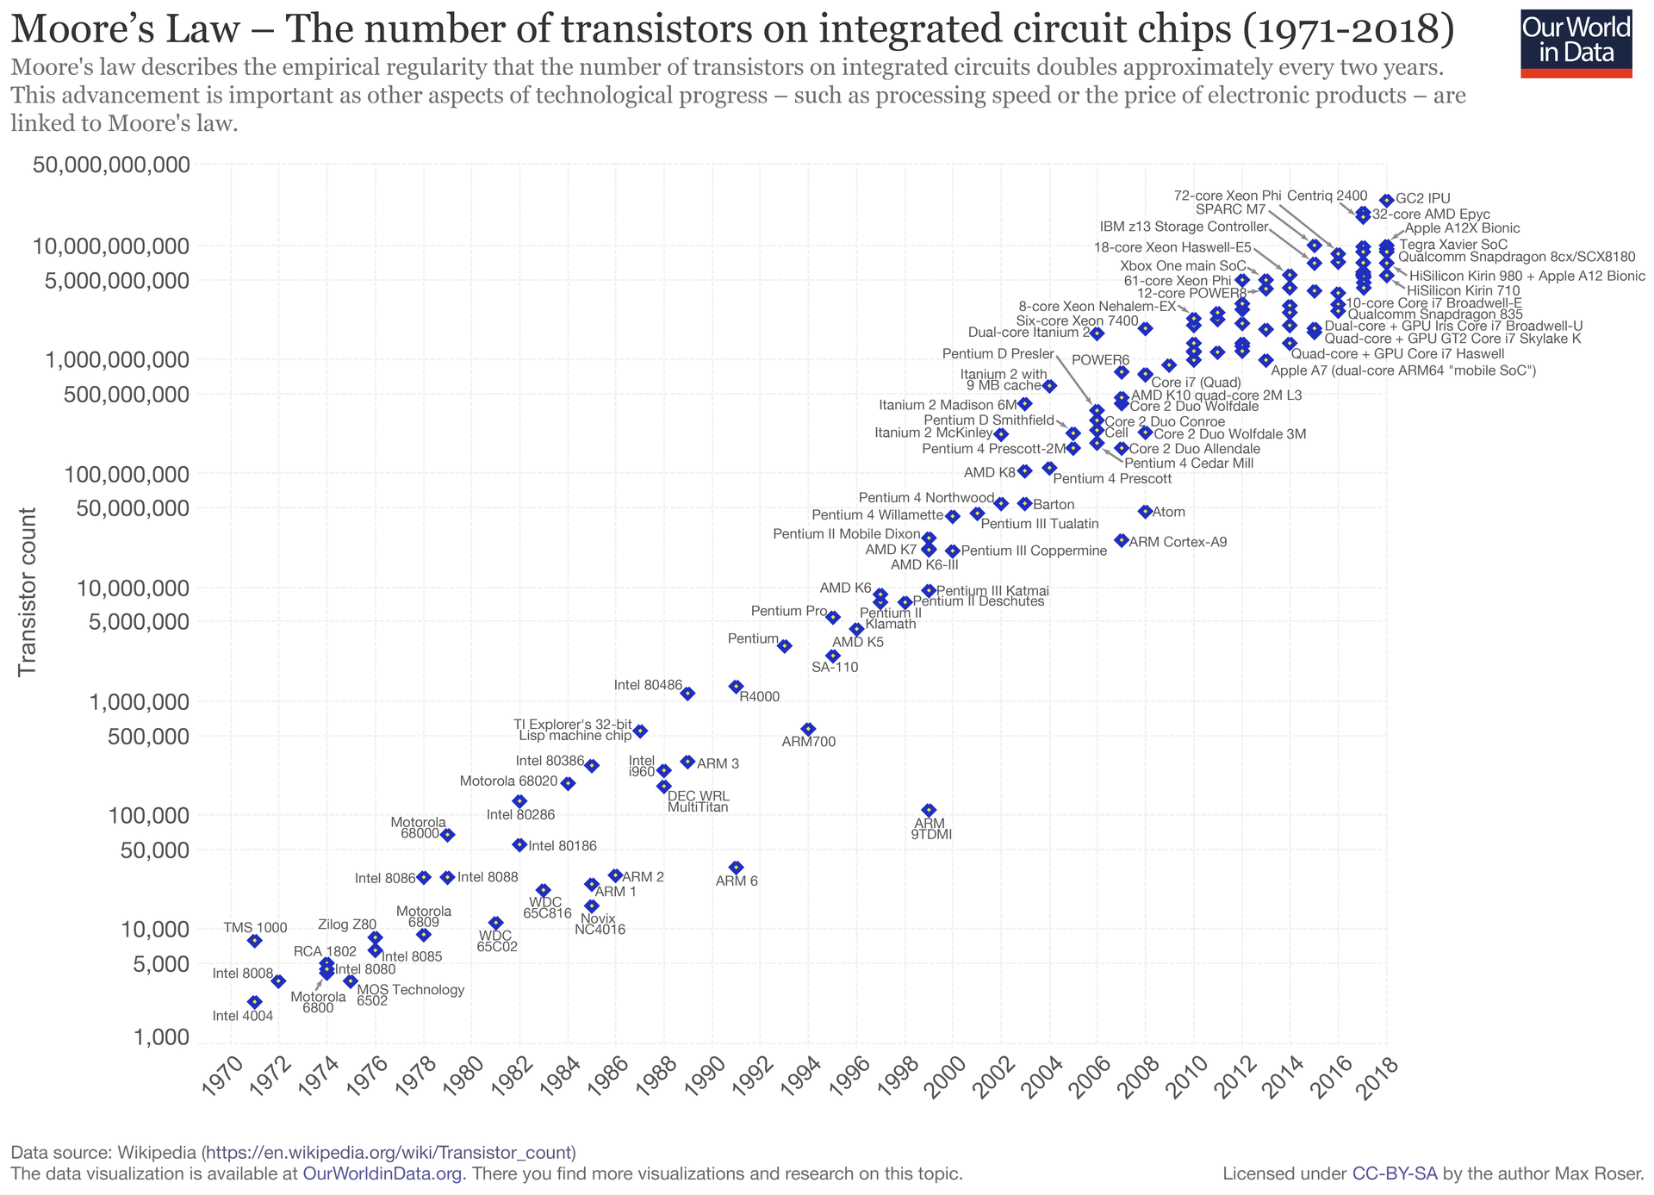

Slide 22
Outline
1
Review
2
The Transistor
3
Logic Gates
4
Summary

Slide 23
Approach: Bottom Up
ALU
Full Adder
_{Integrated Circuit Design}
_{100 Modules/ IC}
_{0.25M~20G Devices}
Register Transfer Level (RTL) Design
_{1K~10K Cells/Module}
_{(100K Devices)}
Now, You are Here.
A
B
C_{in}
_{Gate Level Design}
_{Transistor Physical Layout}
+
Clk
Register
C_{out}
S
_{Scheme for}
_{Representing Information}
_{Circuit Level Design}
_{（Transistor Level Design）}
_{(2~8 Devices/Gate)}
Register Transfer Level (RTL) Design
_{2~16 Gates/Cell}
_{(16~64 Devices)}

Slide 24
Great Idea #3: Abstraction Helps Us Manage Complexity
Application
Solve a system of equations
Algorithm and Data Structure
Gaussian
elimination
Jacobi
iteration
Programming Language/Compiler
Red-black SOR
Multigrid
Operating System/Virtual Machines
Instruction Set Architecture (ISA)
FORTRAN
C
C++
Java
Microarchitecture
Sun SPARC
Intel x86
IBM PowerPC
Gates/Register-Transfer Level (RTL)
Pentium 4
Core 2 Duo
AMD Athlon X2
Analog/Digital Circuits
Electronic Devices
Ripple-carry adder
Carry-lookahead adder
Physics
Static CMOS
Dynamic CMOS
Nanomechanical

Slide 25
Great Idea #4: Software and Hardware Co-design
Application
Algorithm & Data Structure
Language
Software
Machine Architecture, ISA
Hardware
Microarchiture
Logic and IC
Now, You are Here.
Device
Computer System: Layers of Abstraction
Notes:
25

Slide 26
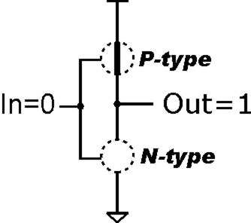
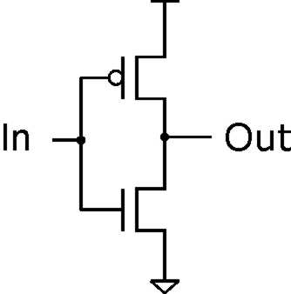
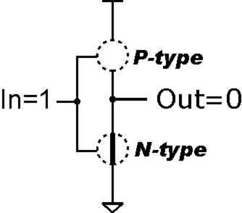
Inverter (NOT Gate)
2.9V
Truth table
0V
In | Out
0 V | 2.9 V
2.9 V | 0 V
In | Out
0 | 1
1 | 0
Notes:
26

Slide 27
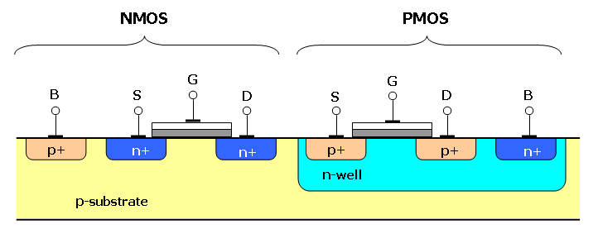
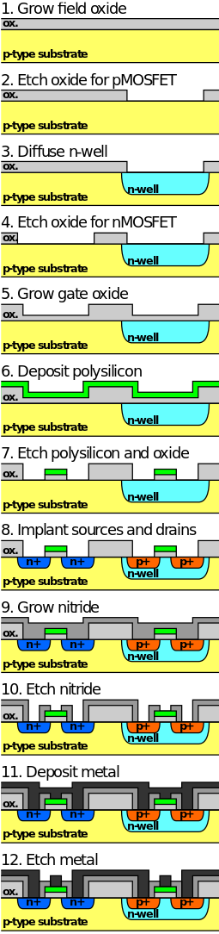
The process of fabrication of a CMOS inverter
Simplified process of fabrication of a CMOS inverter on p-type substrate in semiconductor microfabrication.

Slide 28
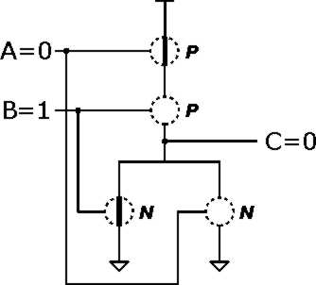
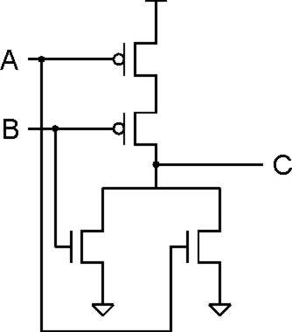
NOR Gate
INPUT |  | OUTPUT
A | B | C
0 | 0 | 1
0 | 1 | 0
1 | 0 | 0
1 | 1 | 0
A | B | C
0 | 0 | 1
0 | 1 | 0
1 | 0 | 0
1 | 1 | 0
Note: Serial structure on top, parallel on bottom.
Notes:
28

Slide 29
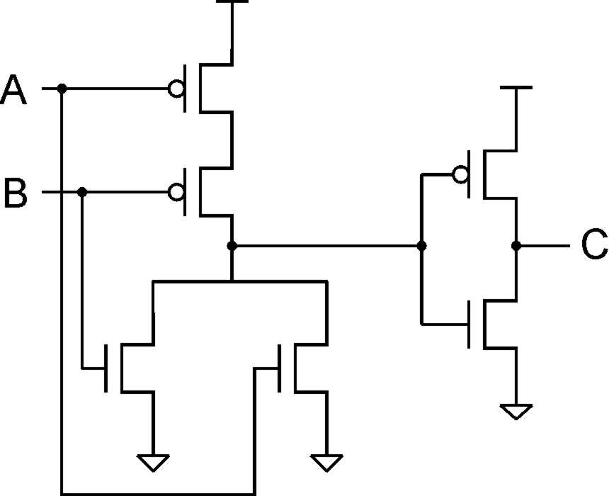
OR Gate
INPUT |  | OUTPUT
A | B | C
0 | 0 | 0
0 | 1 | 1
1 | 0 | 1
1 | 1 | 1
A | B | C
0 | 0 | 0
0 | 1 | 1
1 | 0 | 1
1 | 1 | 1
Add inverter to NOR.

Slide 30
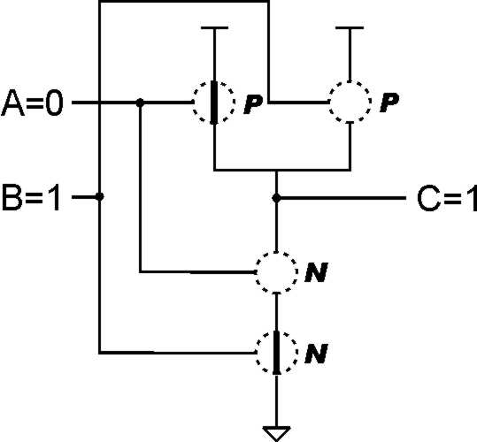
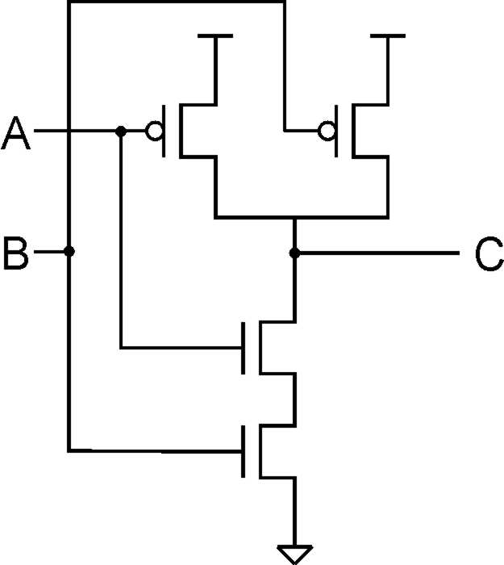
NAND Gate (AND-NOT)
INPUT |  | OUTPUT
A | B | C
0 | 0 | 1
0 | 1 | 1
1 | 0 | 1
1 | 1 | 0
A | B | C
0 | 0 | 1
0 | 1 | 1
1 | 0 | 1
1 | 1 | 0
Note: Parallel structure on top, serial on bottom.
Notes:
30

Slide 31
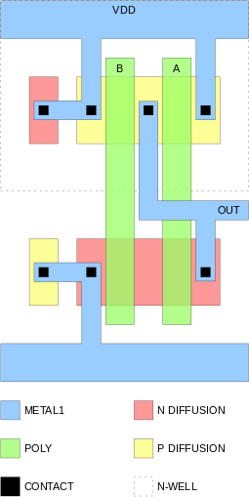
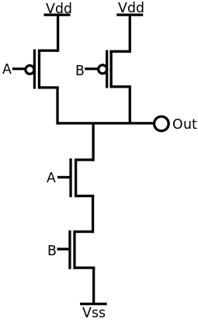
Example: NAND gate in physical layout
NAND gate in CMOS logic
The physical layout of a NAND circuit. The larger regions of N-type diffusion and P-type diffusion are part of the transistors. The two smaller regions on the left are taps to prevent latchup.

Slide 32
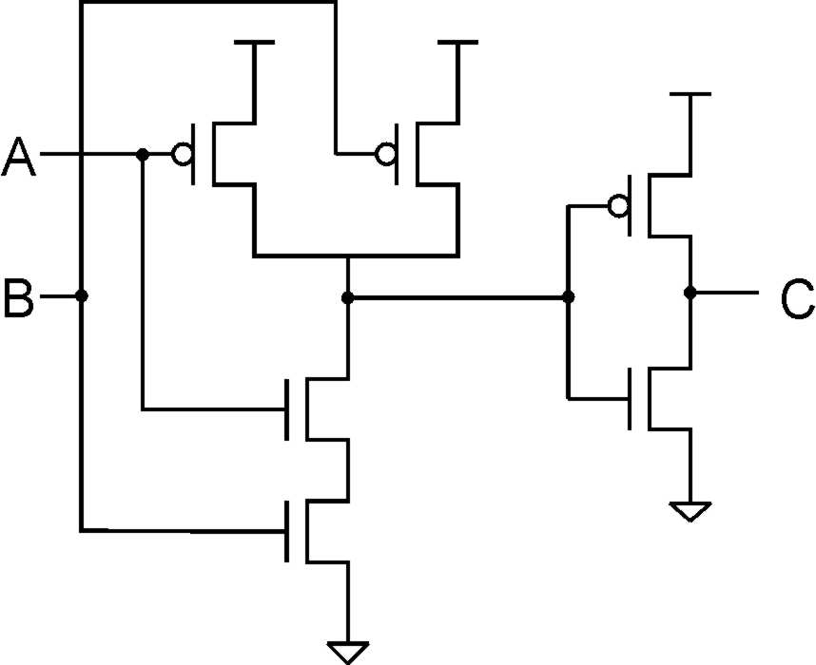
AND Gate
INPUT |  | OUTPUT
A | B | C
0 | 0 | 0
0 | 1 | 0
1 | 0 | 0
1 | 1 | 1
A | B | C
0 | 0 | 0
0 | 1 | 0
1 | 0 | 0
1 | 1 | 1
Add inverter to NAND.

Slide 33
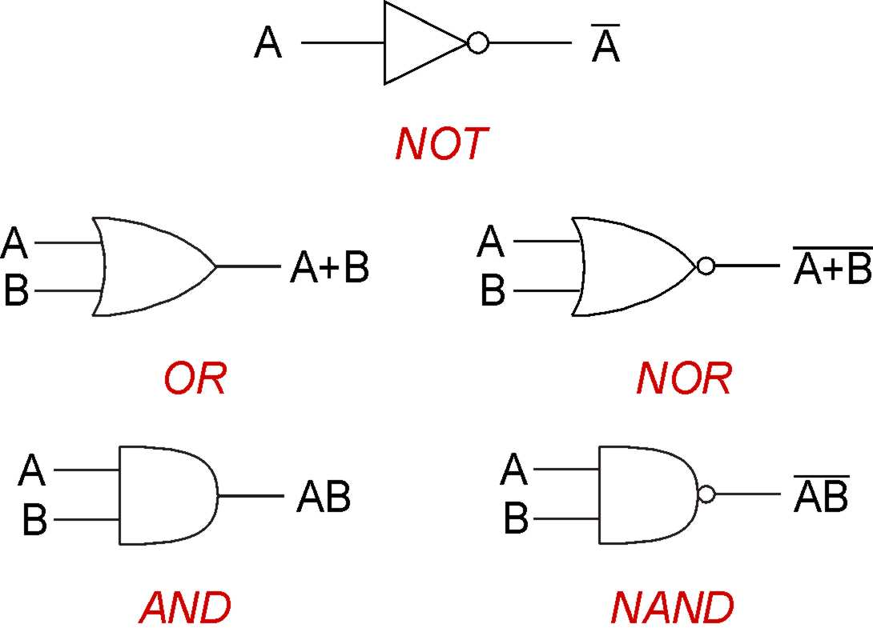
Basic Gates
From Now on……Gates
Covered transistors mostly so that you know they exist
Note: “Logic Gate” not related to “Gate” of transistors
Will study implementation in terms of gates
Circuits that implement Boolean functions
More complicated gates from transistors possible
XOR, Multiple-input AND-OR-Invert (AOI) gates

Slide 34
Practice
Implement a 3-input NOR gate with CMOS.

Slide 35
Practice
A | B | C
0 | 0 | 0
0 | 1 | 1
1 | 0 | 1
1 | 1 | 0
Notes:
35
In ECE 352, you'll learn how to minimize logic functions -- to implement them with the fewest number of gates.

Slide 36

More than 2 Inputs?
AND/OR can take any number of inputs.
AND = 1 if all inputs are 1.
OR = 1 if any input is 1.
Similar for NAND/NOR.
Can implement with multiple two-input gates, or with single CMOS circuit.

Slide 37
Visual Shorthand for Multi-bit Gates
Use a cross-hatch mark to group wires
Example: calculate the AND of a pair of 4-bit numbers
A3 is “high-order” or “most-significant” bit
If “A” is 1000, then A₃ = 1, A₂ = 0, A₁ = 0, A₀ = 0

Slide 38
Shorthand for Inverting Signals
Invert a signal by adding either
A before/after a gate
A “bar” over letter

Slide 39

Logical Completeness
A | B | C | D
0 | 0 | 0 | 0
0 | 0 | 1 | 0
0 | 1 | 0 | 1
0 | 1 | 1 | 0
1 | 0 | 0 | 0
1 | 0 | 1 | 1
1 | 1 | 0 | 0
1 | 1 | 1 | 0
1. AND combinations that yield a "1" in the truth table.
2. OR the results of the AND gates.
AND, OR, NOT can implement ANY truth table
Notes:
39
Note the use of the bubbles (NOT) in the input.

Slide 40
Logical Completeness
AND, OR, NOT can implement ANY truth table

Slide 41
DeMorgan's Law
Converting AND to OR (with some help from NOT)
Consider the following gate:
To convert AND to OR
(or vice versa),
invert inputs and output.
A | B
0 | 0 | 1 | 1 | 1 | 0
0 | 1 | 1 | 0 | 0 | 1
1 | 0 | 0 | 1 | 0 | 1
1 | 1 | 0 | 0 | 0 | 1
Same as A OR B!
Why might this be useful?
Notes:
41
If there's time, perhaps discuss how all gates can be implemented with NAND (or NOR).
Therefore, you can implement any truth table using only NAND (or NOR) gates.

Slide 42
Outline
1
Review
2
The Transistor
3
Logic Gates
4
Summary

Slide 43
N-type MOS Transistor
Gate = 1
Gate = 0
Terminal #2 must be
connected to GND (0V).
MOS = Metal Oxide Semiconductor
two types: N-type and P-type
N-type
when Gate has positive voltage, short circuit between #1 and #2 (switch closed)
when Gate has zero voltage, open circuit between #1 and #2 (switch open)
Notes:
43

Slide 44
P-type MOS Transistor
Gate = 1
Gate = 0
Terminal #1 must be
connected to +2.9V.
P-type is complementary to N-type
when Gate has positive voltage, open circuit between #1 and #2 (switch open)
when Gate has zero voltage, short circuit between #1 and #2 (switch closed)
Notes:
44

Slide 45

Gates

